Slide 1
Phase 1 Updated Exploration and First Expansion Data for DLL3-Targeted T-cell Engager Tarlatamab in SCLC
(DeLLphi-300 Study)
Hossein Borghaei,^{1*} Luis Paz-Ares,² Melissa Johnson,³ Stephane Champiat,⁴ Taofeek Owonikoko,⁵ Victoria Lai,⁶ Michael Boyer,⁷ Horst-Dieter Hummel,⁸ Ramaswamy Govindan,⁹ Neeltje Steeghs,¹⁰ Fiona Blackhall,¹¹ Noemi Reguart,¹² Afshin Dowlati,¹³ Yiran Zhang,¹⁴ Nooshin Hashemi Sadraei,¹⁴ Amanda Goldrick,¹⁴ Hiroki Izumi¹⁵
Presented at World Conference on Lung Cancer (WCLC) 2022 Annual Meeting, August 6-9, 2022; Vienna, Austria
SC-AT-AMG 757-00026 0822
Notes:
Affiliations: ¹Fox Chase Cancer Center, Philadelphia/PA/USA; ²Hospital Universitario 12 de Octubre, Madrid/ES; ³Sarah Cannon Research Institute, Nashville/TN/USA; ⁴Gustave Roussy Drug Development Department, Villejuif/FR; ⁵University of Pittsburgh School of Medicine, Pittsburgh/PA/USA; ⁶Memorial Sloan Kettering Cancer Center, New York/NY/USA; ⁷Chris O'Brien Lifehouse, Camperdown NSW/AU; ⁸Comprehensive Cancer Center Mainfranken, University Hospital Wuerzburg, Wuerzburg/DE; ⁹Washington University Medical School, St. Louis/MO/USA; ¹⁰The Netherlands Cancer Institute, Amsterdam/NL; ¹¹The Christie NHS Foundation Trust, Manchester/GB; ¹²Hospital Clinic Barcelona, Barcelona/ES; ¹³University Hospitals Seidman Cancer Center and Case Western Reserve University, Cleveland/OH/USA; ¹⁴Amgen Inc., Thousand Oaks/CA/USA; ¹⁵National Cancer Center Hospital East, Kashiwa/JP

Slide 2
Diese Präsentation ist urheberechtlich geschützt durch Amgen GmbH. Amgen GmbH stellt dieses Präsentationsmaterial für Angehörige des medizinischen Fachkreises mit Zugang zur Oncology Horizons Webseite zur Verfügung. Es dient ausschließlich zur eigenen Verwendung und darf nicht an Dritte weitergeleitet werden. Es dürfen keine inhaltlichen Änderungen vorgenommen werden.
SC-AT-NP-00098 06.21

Slide 3
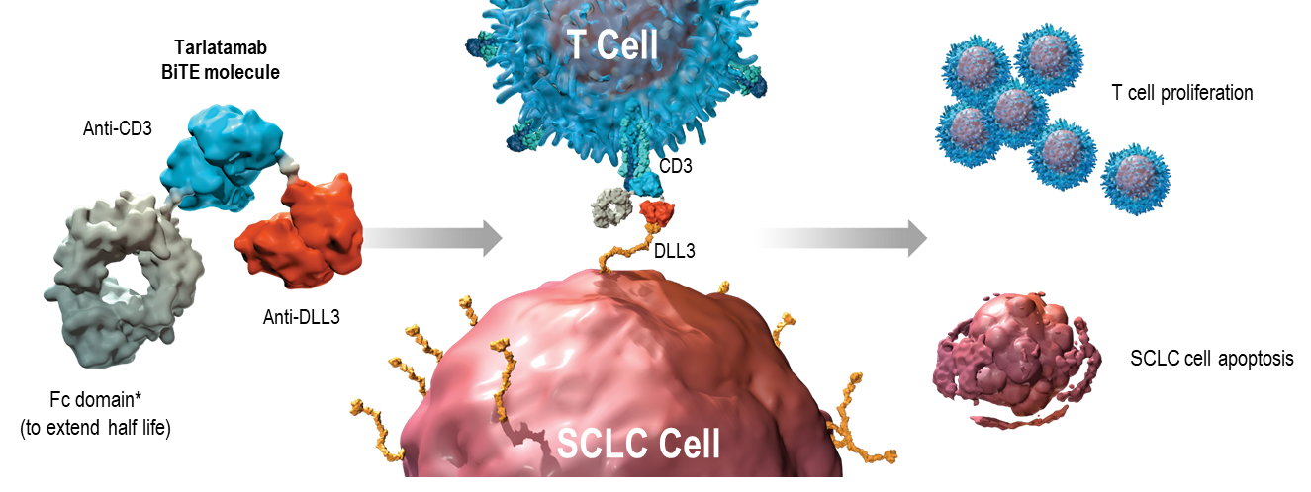
Introduction
Small cell lung cancer (SCLC) is an aggressive disease with limited treatment options beyond first-line chemo-immune therapy^{1,2}
Notch ligand delta-like ligand 3 (DLL3) is aberrantly expressed on the surface of SCLC cells^{3,4}
Tarlatamab is a bispecific T cell engager (BiTE®) immune therapy that binds DLL3 and CD3 leading to
T cell-mediated tumor lysis⁵
                Interim phase 1 dose exploration data show preliminary efficacy and acceptable safety in SCLC patients⁶
T Cell
SCLC
Cell
*Effector-functionless Fc domain; CD3, cluster of differentiation 3; DLL3, delta-like ligand 3; Fc, fragment crystallizable; SCLC, small cell lung cancer
1. Sabari JK, et al. Nat Rev Clin Oncol. 2017;14:549-561. 2. Mathieu L, et al. Oncologist. 2021;26:433-438. 3. Leonetti A, et al. Cell Oncol (Dordr). 2019;42:261-273. 4. Saunders LR, et al. Sci Transl Med. 2015;7:302ra136. 5. Giffin MJ, et al. Clin Cancer Res. 2021;27:1526-1537. 6. Owonikoko TK, et al. Abstract 8510. Presented at: ASCO Annual Meeting, June 4–8, 2021; Virtual.

Slide 4
First-in-Human Study of Tarlatamab
Tarlatamab in Relapsed/Refractory SCLC
Primary
Objectives
Evaluate safety and tolerability in SCLC
Determine MTD or RP2D
Dose Exploration (0.003-100 mg)
Secondary
Objectives
Characterize PK
Evaluate preliminary antitumor activity
Optimization of
dose & regimen
Dose Expansion (100 mg)
Exploratory
Objectives
Evaluate immunogenicity of tarlatamab
Assess biomarker expression
Exploratory
Objectives
Evaluate immunogenicity, biomarkers, and target protein & outcomes
Data cutoff of 15 June 2022, median follow-up time of 8.5 months (range, 0.2–30.7)
Disease assessment – Antitumor activity assessed using modified RECIST 1.1 every 8 ± 1 weeks
IV, intravenous; MTD, maximum tolerated dose; PK, pharmacokinetics; RECIST, response evaluation criteria in solid tumors;RP2D, recommended phase 2 dose; SCLC, small cell lung cancer.
Borghaei H, et al. Presented at World Conference on Lung Cancer (WCLC) 2022 Annual Meeting, August 6-9, 2022; Vienna, Austria.

Slide 5
Key Eligibility Criteria & Patient Characteristics
Inclusion Criteria
Baseline Characteristic | All Patients (N = 106)
Median age, years (range) | 64 (32–80)
Current/former smoker, n (%) | 13 (12) / 81 (76)
ECOG performance status: 0–1, n (%) | 105 (99)
Prior lines of therapy, n (%)
1 | 30 (28)
2 | 44 (42)
≥ 3 | 32 (30)
Median (range) | 2 (1–6)
Prior anti-PD-(L)1 treatment, n (%) | 52 (49)
Extensive stage disease at initial diagnosis, n (%) | 99 (93)
Known liver / brain* metastases, n (%) | 54 (51) / 29 (27)
Histologically/cytologically confirmed SCLC
  Progressed/recurred following ≥ 1 platinum-based chemotherapy (including a PD-L1 inhibitor, if standard of care)
ECOG performance status: 0–2
≥ 2 measurable lesion(s)
Exclusion Criteria
Untreated or symptomatic brain metastases
Prior anti-cancer therapy within 28 days
Immunodeficiency or systemic steroid use
Interstitial lung disease
ECOG, Eastern Cooperative Oncology Group; PD-1, programmed death-1; PD-L1, programmed death-ligand 1; SCLC, small cell lung cancer.
* Patients with treated brain metastases permitted, with conditions.
Borghaei H, et al. Presented at World Conference on Lung Cancer (WCLC) 2022 Annual Meeting, August 6-9, 2022; Vienna, Austria.
Notes:
Patients who had received conventional chemotherapy up to 14 days before enrollment were eligible as long as all treatment-related toxicity had resolved to grade ≤ 1

Slide 6
Treatment-Related Adverse Events Summary
Treatment-related AEs (by preferred term) | Patients (N = 106)
 | All Grades, n (%) | Grade ≥ 3, n (%)*
Any treatment-related AE | 97 (92) | 33 (31)
Treatment-related AEs occurring in > 15% of patients (by preferred term)
CRS | 56 (53) | 1 (1)
Pyrexia | 40 (38) | 2 (2)
Dysgeusia | 24 (23) | 0
Fatigue | 23 (22) | 3 (3)
Nausea | 21 (20) | 0
4/106 (4%) patients discontinued tarlatamab due to treatment-related AEs: encephalopathy (n=1), neurotoxicity (n=1), and pneumonitis (n=2, including one grade 5 AE)
Tarlatamab showed a manageable safety profile across evaluated doses
*Includes one patient with grade 5 pneumonitis; AE, adverse event; CRS, cytokine release syndrome.
Borghaei H, et al. Presented at World Conference on Lung Cancer (WCLC) 2022 Annual Meeting, August 6-9, 2022; Vienna, Austria.
Notes:
Exposure to tarlatamab summary: Median treatment duration was 11.6 weeks (range, 0.1–80.0); median number of doses per subject was 6.0 (range, 1–41); median number of cycles started was 3.0 (range, 1 to 20).

Slide 7
Treatment-Related AEs of Interest
Events of Interest (AMQN) | All Patients (N = 106)
 | All grades n (%) | Grade ≥ 3 n (%)
CRS* | 56 (53) | 1 (1)
Neurologic events† | 53 (50) | 7 (7)
Neutropenia‡ | 17 (16) | 10 (9)
CRS AEs (Lee, 2014) were mostly grade 1, occurred in cycle 1 and rarely recurred in subsequent cycles, and were generally manageable; no grade 4/5 CRS
    8/106 patients [8%] required tocilizumab for CRS
  Treatment-related neurologic events (NEs) were predominantly grade 1 and either dysgeusia or headache
    Confusion was the most common grade ≥ 3 treatment-related NE (n=5). Confusion was the only grade 4 NE on the study (n=1)
  Grade 4 treatment-related neutropenia occurred in 4 patients (4%); no cases of febrile neutropenia
AMQN, Amgen MedDRA query narrow; CRS, cytokine release syndrome; NE, neurologic event. *CRS includes cytokine abnormal, cytokine release syndrome, cytokine storm, cytokine test; †Neurologic Events based on "Central neuropsychiatric events due to direct neurotoxicities” search and was graded using CTCAE version 4.0; ‡Neutropenia based on AMQN search and graded using CTCAE version 4.0.
Borghaei H, et al. Presented at World Conference on Lung Cancer (WCLC) 2022 Annual Meeting, August 6-9, 2022; Vienna, Austria.
Notes:
Amgen MedDRA query narrow search
• All events Coded using MedDRA version: 25.0.
• Cytokine Release Syndrome includes Cytokine abnormal, Cytokine release syndrome, Cytokine storm, Cytokine test. CRS events graded using CRS Lee et al. (2014) criteria.
• Neurologic Events based on "Central neuropsychiatric events due to direct neurotoxicities". Neurologic events graded using CTCAE version 4.0.
• Neutropenia based on AMQ narrow search. Neutropenia graded using CTCAE version 4.0.

Slide 8
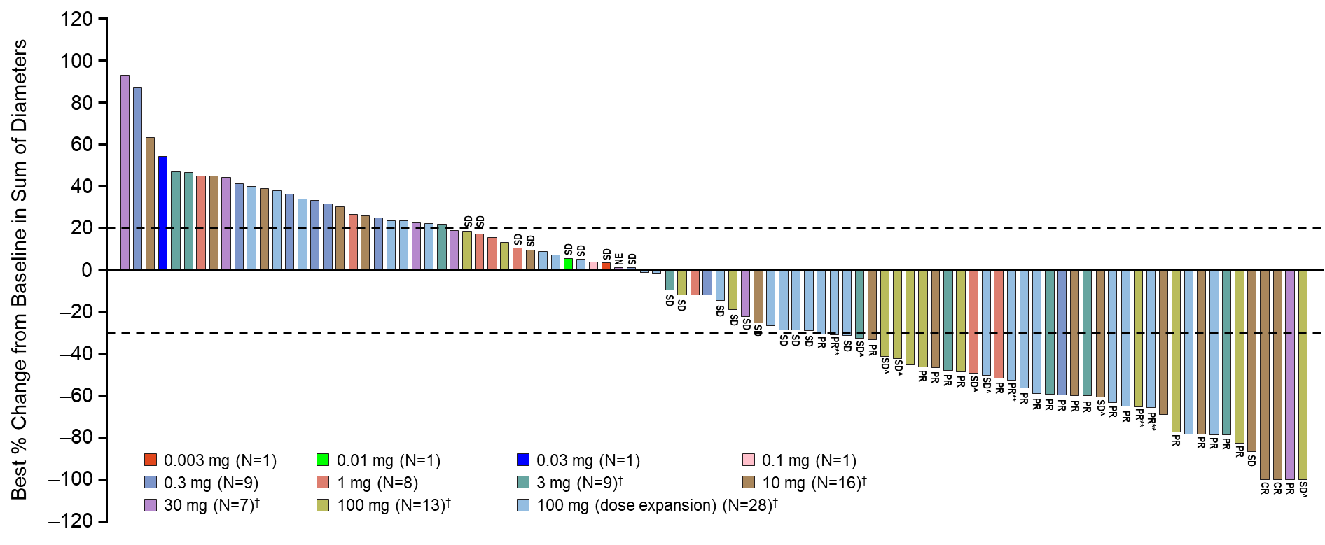
Tarlatamab Induces Response in Previously Treated SCLC
Confirmed ORR, 23% (2 CRs, 22 PRs); 37% of patients with target lesion shrinkage ≥ 30%
† Indicates step dosing with 1 mg run-in dose. Plot includes patients who received ≥ 1 dose of tarlatamab, had at least 9 weeks follow-up after first dose of tarlatamab, and had sum of diameters available in post-baseline assessments. Unlabeled bars include confirmed and unconfirmed PD. CR, complete response; NE, not evaluable; ORR, objective response rate; PD, progressive disease; PR, partial response; SD, stable disease. PR** indicates patients had an initial PR and still have potential for future confirmative scans; SD^ indicates patients had an initial response but did not have confirmation of response on the subsequent scan.
Borghaei H, et al. Presented at World Conference on Lung Cancer (WCLC) 2022 Annual Meeting, August 6-9, 2022; Vienna, Austria.
Notes:
The waterfall plot presents tumor shrinkage and BOR. Subjects needed to have post-baseline assessment and sum of diameters available to be presented in the waterfall plot

Slide 9
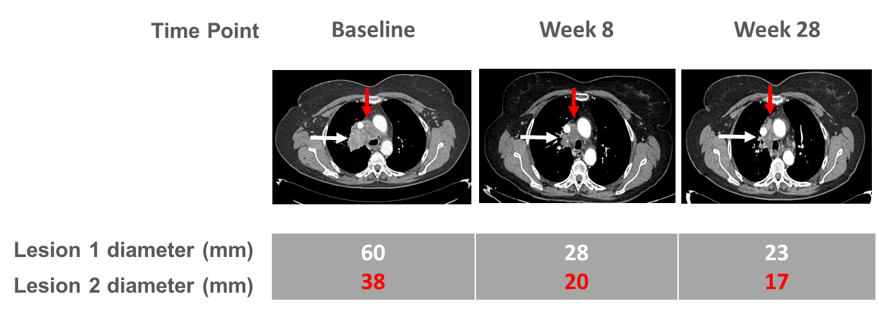
Tarlatamab Induces Response in Previously Treated SCLC
Summary of Objective Responses
Modified RECIST 1.1 Response | Patients* (N = 105) n (%)
ORR, n (%)
Confirmed and unconfirmed | 29 (28)
Confirmed | 24 (23)
Disease control rate, n (%) | 55 (52)
Best overall response, n (%)
Confirmed CR | 2 (2)
Confirmed PR | 22 (21)
Stable disease | 31 (30)
Progressive disease | 8 (8)
Could not be evaluated† | 35 (33)
Unconfirmed PD† | 33 (31)
No assessment‡ | 7 (7)
Example of Tarlatamab Response (Patient from 10 mg cohort)
CR, complete response; ORR, objective response rate; PD, progressive disease; PR, partial response; RECIST, response evaluation criteria in solid tumors.
* The Interim efficacy analysis set is a subset of the safety analysis set. The Interim efficacy analysis set include patients whose data cut-off date is at least 9 weeks after the first dose date; † Category “Could not be evaluated” includes 33 patients who had PD in the post-baseline scan however without further confirmation scan (unconfirmed PD per modified RECIST 1.1); ‡ Reasons for no imaging assessment included consent withdrawn (n=3), death (n=2), clinical PD (n=1), and starting new anticancer therapy (n=1).
Borghaei H, et al. Presented at World Conference on Lung Cancer (WCLC) 2022 Annual Meeting, August 6-9, 2022; Vienna, Austria.
Notes:
Patient A: A 67-year-old female with small cell lung cancer progressed after three prior lines of chemotherapy and prophylactic cranial irradiation (PCI - WBRT). Patient was enrolled in the 10 mg tarlatamab dose cohort. At screening patient showed disease manifestations at lung and mediastinal lymph nodes with the sum of the index lesion at 122mm.
A representative contrast-enhanced CT image of chest revealed 2 index lesions. Lesion 1: Para-mediastinal mass in the right upper lobe of the lung (white arrow). Lesion 2: Mediastinal adenopathy at right paratracheal (red arrow). Over the course of tarlatamab treatment, on week 8 the diameter of the lesion 1 was decreased from 60mm at baseline to 28mm (-56.7%) and the size of lesion 2 shrunk from 38mm to 20mm (-47.4%). On week 28, the size of lesion 1 continued to shrink to 23mm (-61.7%) and lesion 2 also decreased to 17mm (-55.3%). The observed overall partial response from week 8 was confirmed on week 16 and remained until week 37.

Slide 10
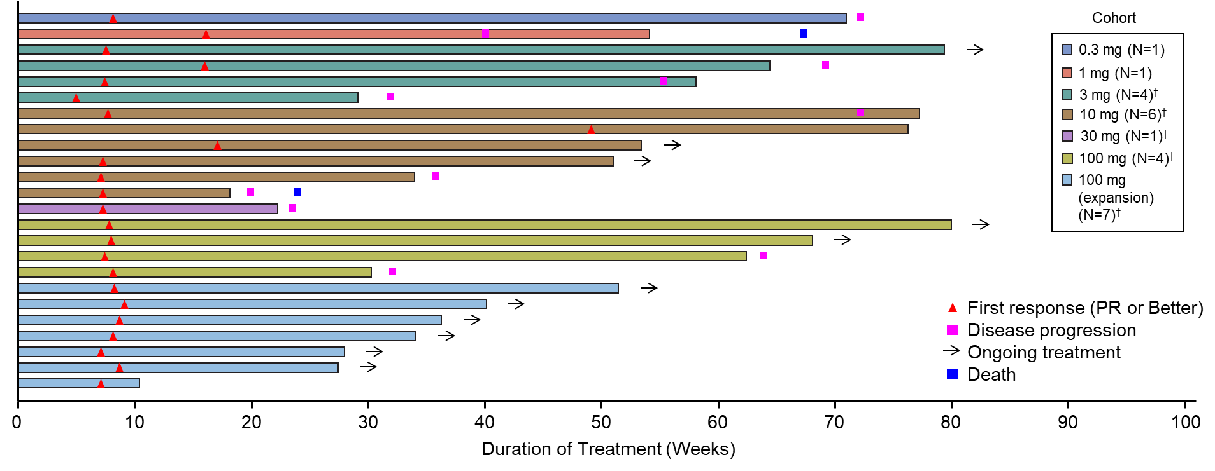
Tarlatamab Delivers Durable Responses in Previously Treated SCLC
Duration of Response in Confirmed Responders (n=24)
Median duration of response was 13.0 months (95% CI: 6.2, 14.9)*
  11 responders had treatment ongoing as of data cutoff, including 2 complete responders
  Median time to response was 1.8 months (range: 1.2–7.4)
CI, confidence interval; PR, partial response; SCLC, small cell lung cancer.
Bar graph includes all patients with confirmed response (n = 24), with each bar representing 1 patient. *The interim time to event analysis set used in the duration of response analysis includes subjects whose data cut-off date is at least 6 months after first dose date (N=23). † Indicates step dosing with 1 mg run-in dose.
Borghaei H, et al. Presented at World Conference on Lung Cancer (WCLC) 2022 Annual Meeting, August 6-9, 2022; Vienna, Austria.

Slide 11
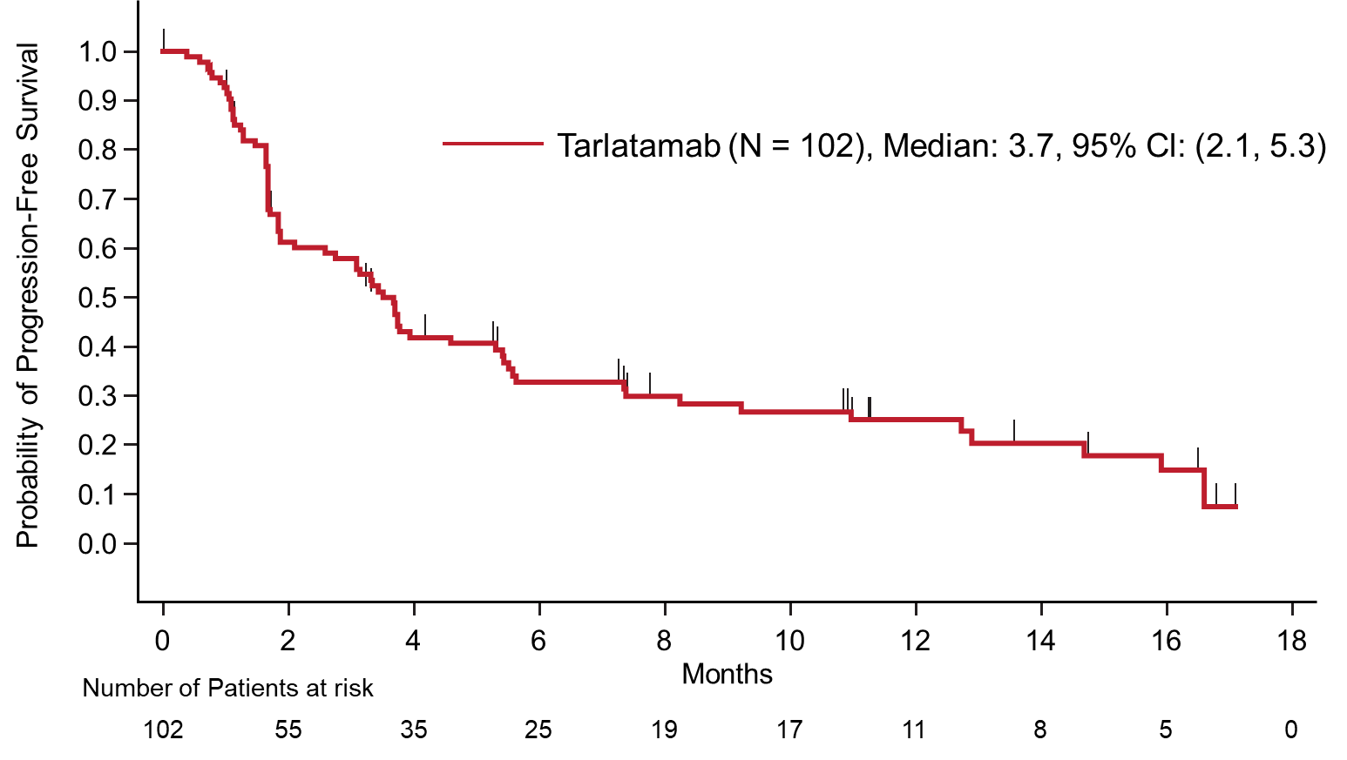
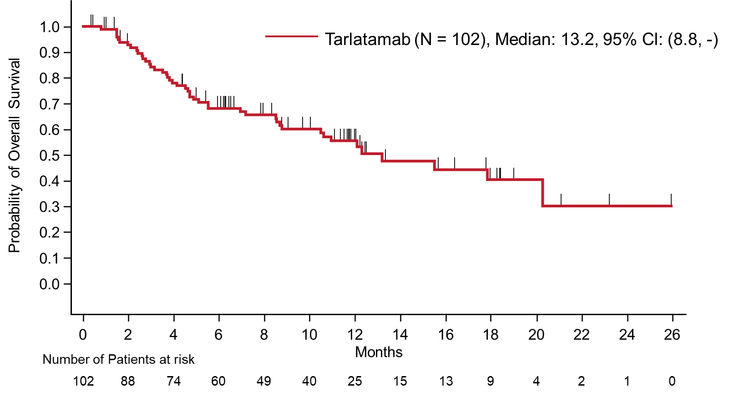
Survival with Tarlatamab in Previously Treated SCLC
Progression-Free Survival
Overall Survival
NE)
Median overall survival of 13.2 months (95% CI: 8.8, NE)
CI, confidence interval; NE, not estimable; SCLC, small cell lung cancer
*Survival analysis population (N=102) included subjects who received their first dose on or prior to 16Dec2021 to allow at least 6 months of follow-up to allow sufficient data maturity before data cutoff.
Borghaei H, et al. Presented at World Conference on Lung Cancer (WCLC) 2022 Annual Meeting, August 6-9, 2022; Vienna, Austria.

Slide 12
Conclusions
Tarlatamab is the first DLL3-targeted immune therapy to undergo clinical evaluation
Tarlatamab demonstrated promising antitumor activity with encouraging response durability in heavily pretreated SCLC
  Tarlatamab delivered confirmed ORR of 23% and median DOR of 13 months
  Median OS of 13.2 months
Tarlatamab demonstrated an acceptable safety profile; CRS was primarily grade 1 and reversible; treatment discontinuation due to treatment-related AEs was low (4%)
Based on these results, a phase 2 registrational study of tarlatamab is underway in SCLC patients exposed to ≥ 2 prior lines of treatment (DeLLphi-301 study [NCT05060016])
AE, adverse event; CRS, cytokine release syndrome; DLL3, delta-like ligand 3; DOR, duration of response; ORR, overall response rate; OS, overall survival.
Borghaei H, et al. Presented at World Conference on Lung Cancer (WCLC) 2022 Annual Meeting, August 6-9, 2022; Vienna, Austria.

Slide 13
Acknowledgments
We are grateful to the patients and their families for participation in this study
Investigators
Australia: Michael Boyer
Austria: Richard Greil, Angelika Terbuch
France: Stephane Champiat
Germany: Horst-Dieter Hummel
Japan: Hiroaki Akamatsu, Hiroki Izumi, Tatsuya Yoshida
Netherlands: Judith Vos de-Geelen, Neeltje Steeghs
Spain: Francisco Javier de Castro, Enriqueta Felip, Maria Eugenia Olmedo, Noemi Reguart, Luis Paz-Ares
Switzerland: Martin Frueh, Solange Peters
United Kingdom: Fiona Blackhall
United States: Hossein Borghaei, Jennifer Carlisle, Anne Chiang, Alberto Chiappori, Afshin Dowlati, Shirish Gadgeel, Ramaswamy Govindan, Christine Hann, Kai He, Melissa L. Johnson, W. Victoria Lai, Taofeek K. Owonikoko, Everett Vokes
Funding for this study was provided by Amgen and medical writing support was provided by Eugene Gillespie and Jacqueline Sayyah (Amgen)
Borghaei H, et al. Presented at World Conference on Lung Cancer (WCLC) 2022 Annual Meeting, August 6-9, 2022; Vienna, Austria.

